Slide 1
8 Motor Skills Activities
Work on Grasping and Releasing objects of various sizes

Slide 2
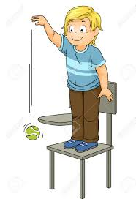
Motor: Grasp and Release
The higher the level the more difficult the task
Level 1
Work on grasping and letting go with intention
Level 2
Work on grasping and releasing objects into a large container
Level 3
Work on grasping and releasing into a small container or stacking
Notes:
Toy recommendations: rings, blocks, buckets of different sizes, toy piggy bank

Slide 3
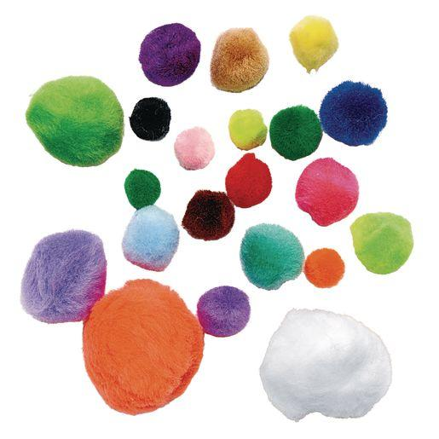
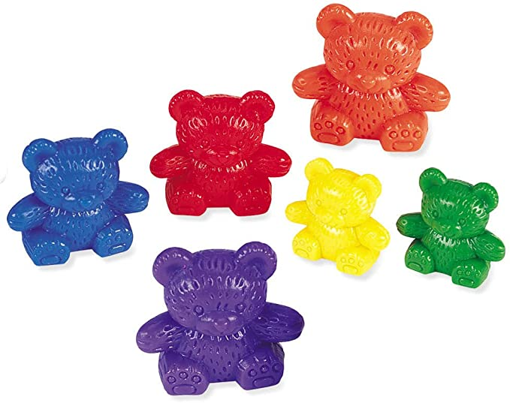
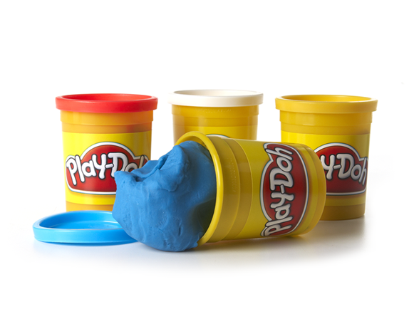
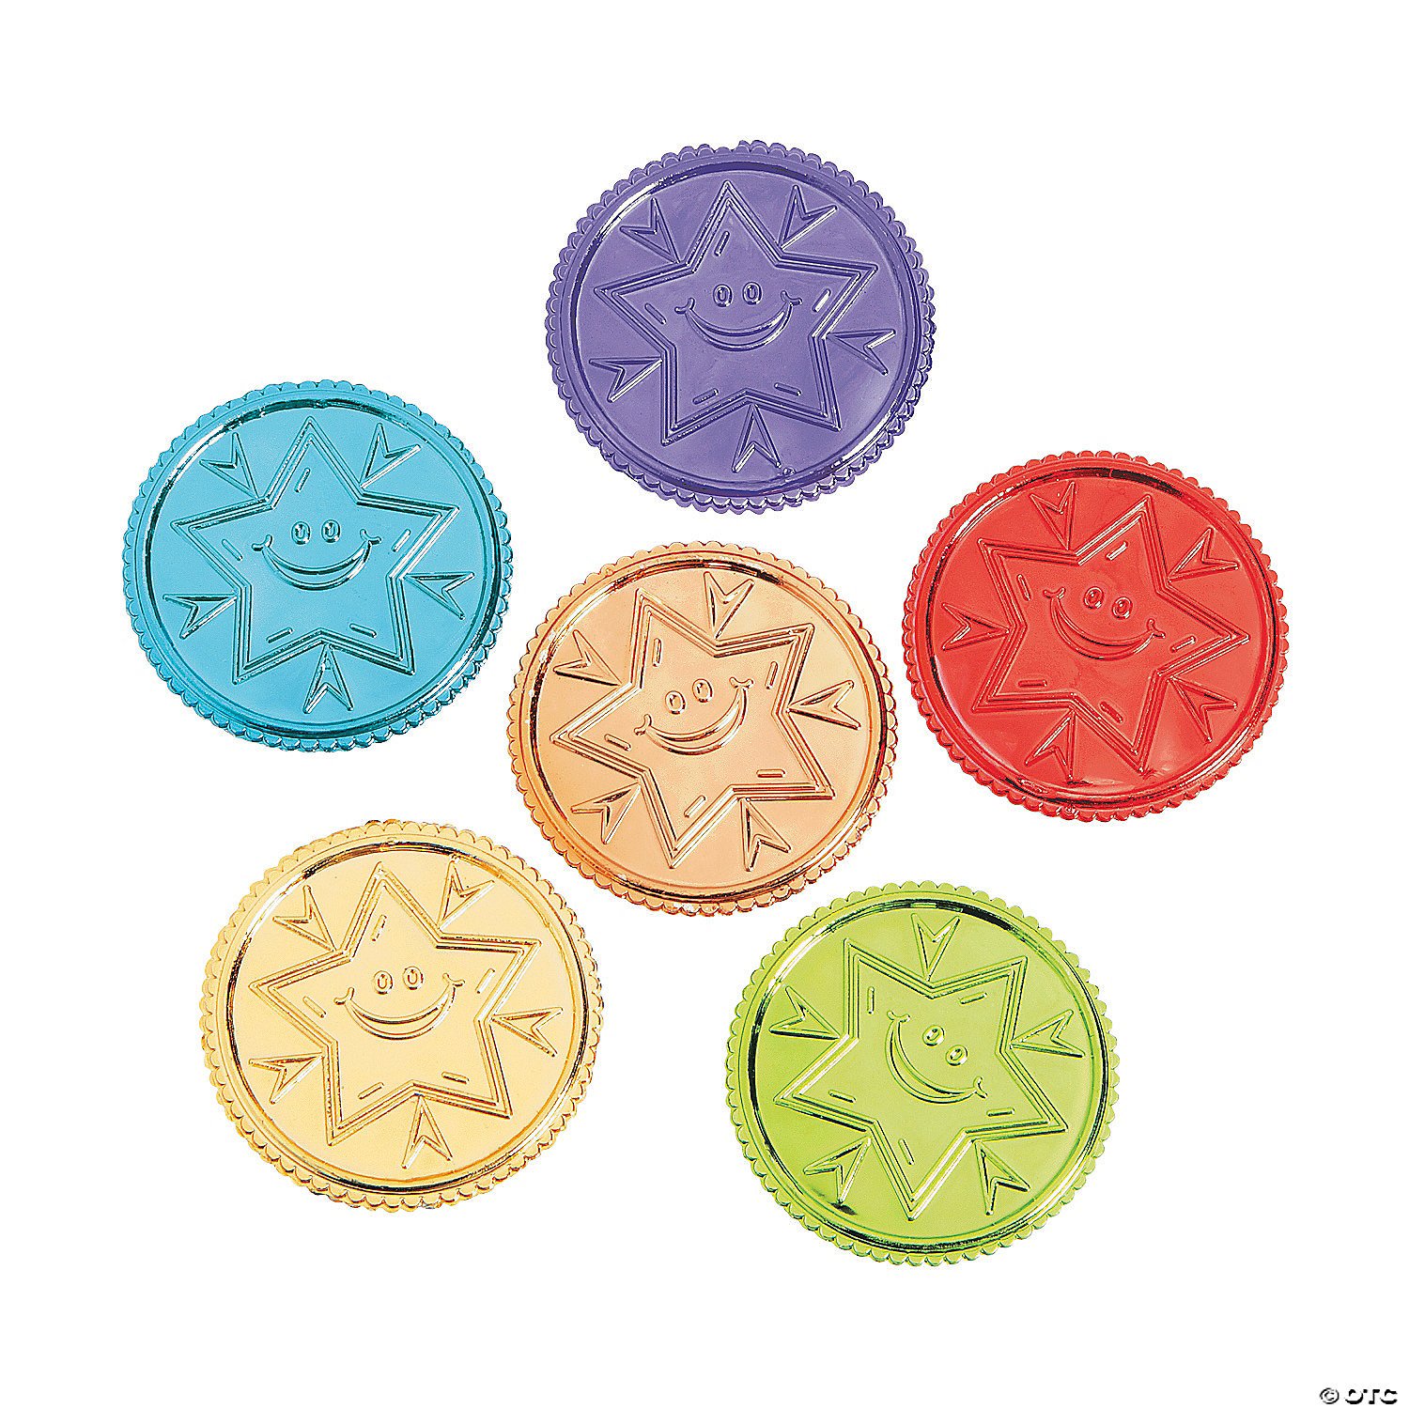
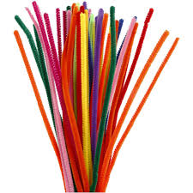
Supplies
Counting bears
Various sized colored construction paper circles to match each colored bear
Playdough (from previous week)
10 various sized cut pipe cleaners
Plastic coins
3 paintbrushes (from previous week)
Assorted paint
15 pom pom balls
Tape (from previous week)
5 balloons
Cups (from previous week)

Slide 4
Activity 1: Counting Bears
The child will place counting bears on matching colored construction paper circles
Supplies: Counting bears, various sized colored construction paper circles that match the colors of the counting bears

Slide 5
Activity 2: Dough Poke
The child will place pipe cleaners in balls of playdough
Supplies: Various sized pipe cleaners, playdough

Slide 6
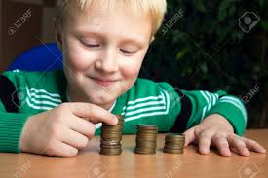
Activity 3: Coin Stacking
Supplies: Coins, plastic bag or container

Slide 7
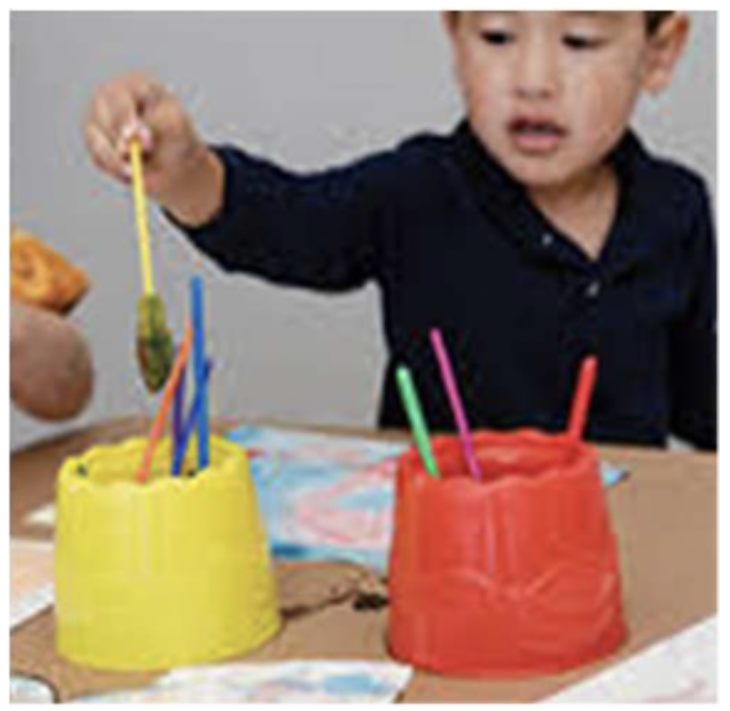
Activity 4: Painting
The child can start with finger painting then using brushes then pom poms to work on a fine pinch.
Supplies: Paint brushes, paint, paper, cups

Slide 8
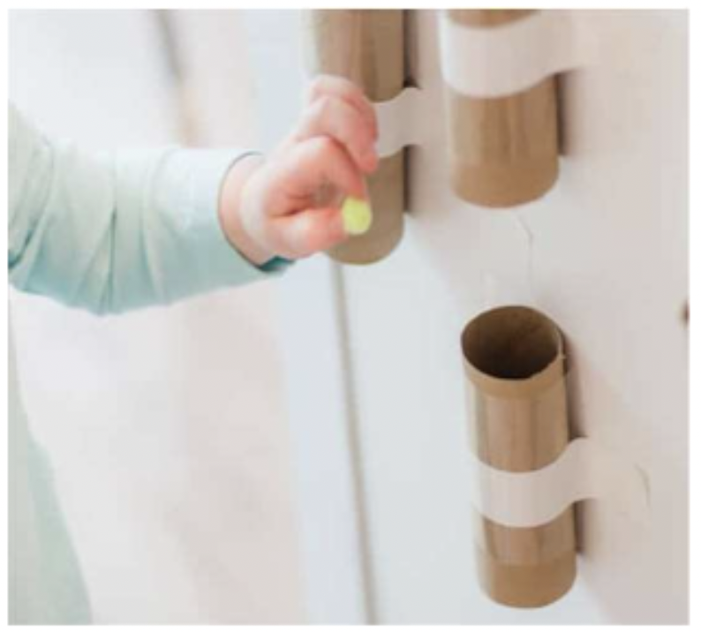
Activity 5: Pom Pom Drop
The child will drop pom pom into the rolls
Supplies: Various pom pom balls, toilet paper rolls or paper towel rolls, tape

Slide 9
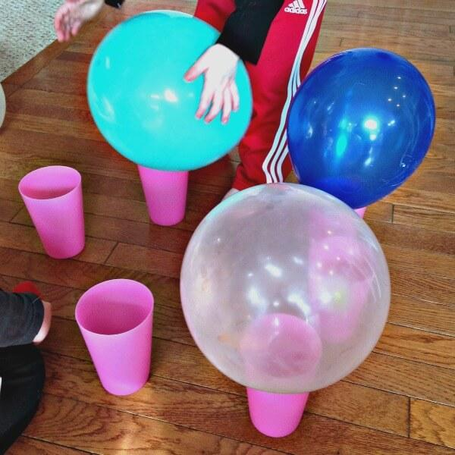
Activity 6: Balloon Balance
balance balloons on recycled toilet paper and paper towel rolls that are taped to table
Supplies: Toilet paper or paper towel recycled roll, or cups, balloons

Slide 10
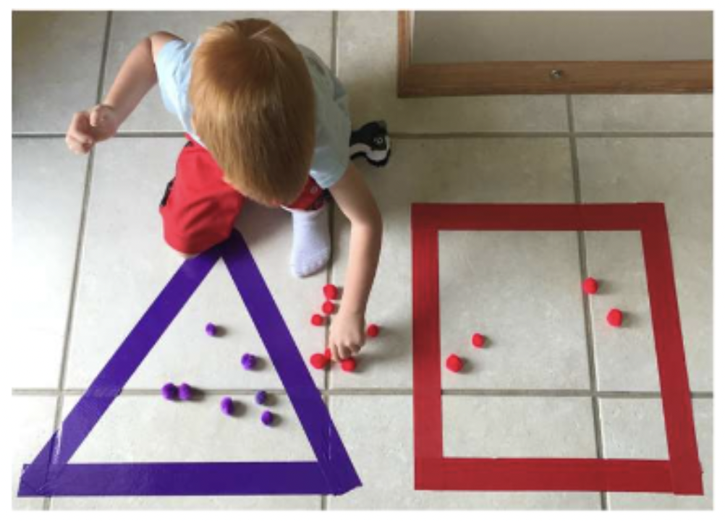
Activity 7: Pom Pom Ball Tape Shape
The child place pom pom balls into tape shape
Supplies: Various pom pom balls, colored tape

Slide 11
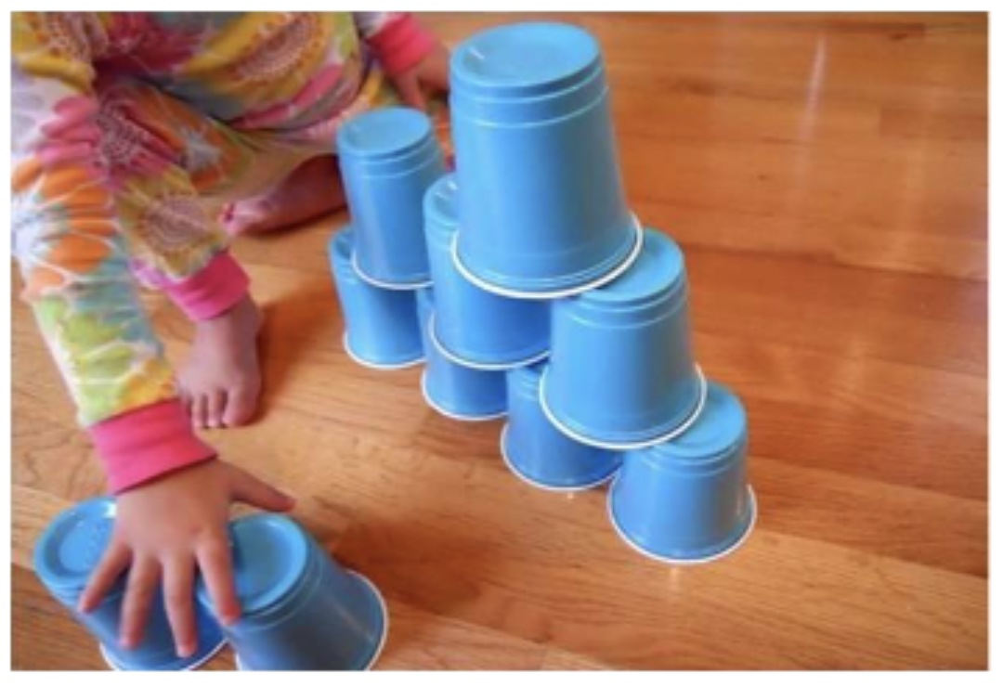
Activity 8: Pyramid Cup Stacking
Supplies: Cups

